Slide 1
BIZKIT
HOME
PRICING& SIGNUP
SERVICES
TOUR
Empowering your Business
Business Kit
Invoice Online
Faster
More Professional
Work anywhere
KNOW MORE
Try it free
for 30 days
Sign Up

Slide 2





BIZBOX
Sign Up NOW
Contact Us
HOME
PRICING& SIGNUP
SERVICES
TOUR
LOGIN
Business Kit
Invoice Online
#92d050
Faster
More Professional
Work anywhere
KNOW MORE
Try it free
for 30 days
Sign Up

Slide 4
BIZKIT
HOME
PRICING& SIGNUP
SERVICES
TOUR
Empowering your Business
Business Kit
Invoice Online
Faster
More Professional
Work anywhere
KNOW MORE
Try it free
for 30 days
Sign Up

Slide 5

BIZKIT
HOME
PRICING& SIGNUP
SERVICES
TOUR
Empowering your Business
Business Kit
Invoice Online
Faster
More Professional
Work anywhere
KNOW MORE
Try it free
for 30 days
Sign Up

Slide 6
BIZKIT
HOME
PRICING& SIGNUP
SERVICES
TOUR
Empowering your Business
Business Kit
Invoice Online
Faster
More Professional
Work anywhere
KNOW MORE
Try it free
for 30 days
Sign Up

Slide 7
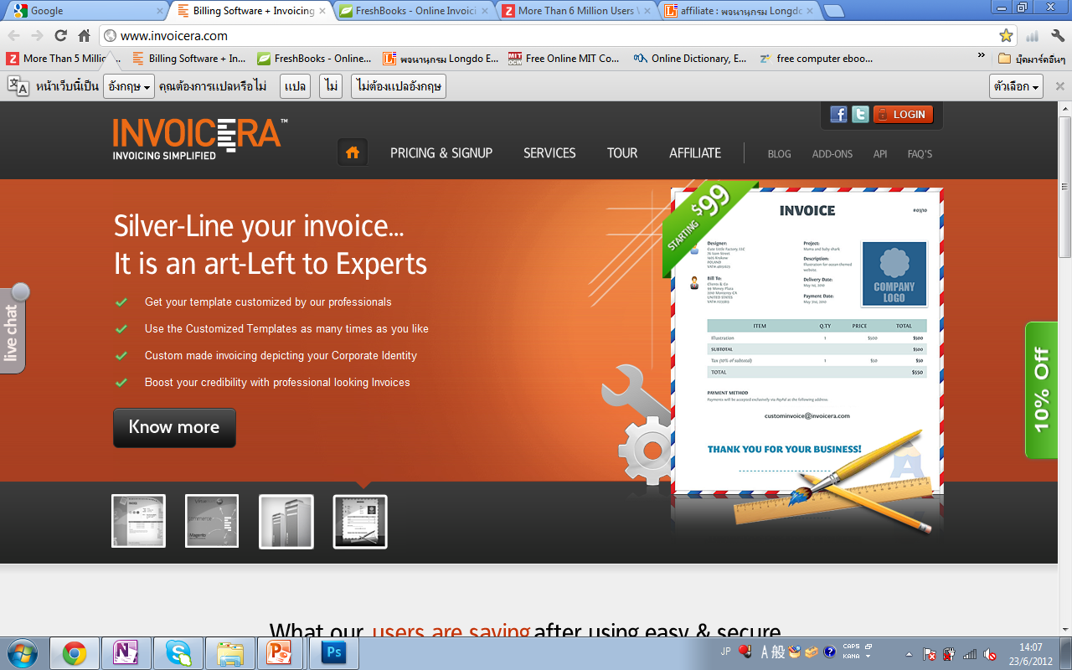

Slide 8
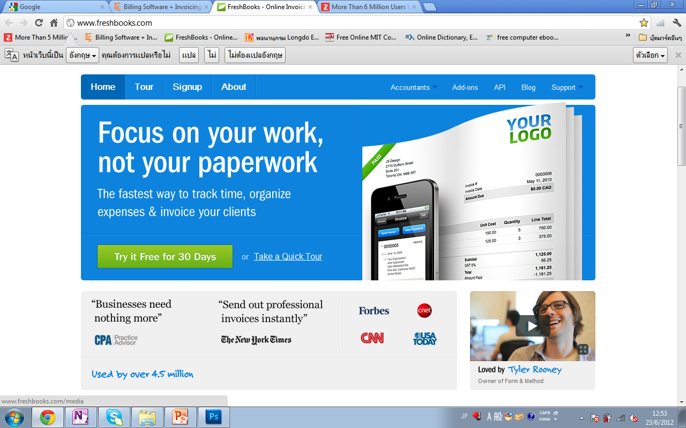

Slide 11
BIZKIT
Empowering your Business
HOME
Business Kit
Invoice Online
Faster
More Professional
Work anywhere
Know More
Try it free
for 30 days
Sign Up

Slide 12
Business Kit
Invoice Online
Faster
More Professional
Work anywhere
Know More
Sign Up
Try it for free

Slide 13
Try Bizkit Free
No Credit Card Required
Bizkit
Home
Privacy Policy
Copyright 2012 © Bizkit
All rights reserved
Features
Data Backup
Pricing
Term of Service
About Us
Feedback

Slide 14
Try Bizkit Free
No Credit Card Required
Bizkit
Home
Privacy Policy
Copyright 2012 © Bizkit
All rights reserved
Features
Data Backup
Pricing
Term of Service
Copyright 2012 © Bizkit
All rights reserved
About Us
Feedback

Slide 15
